Slide 1
Views Materialized views Index
Presented by Prajwol Maharjan

Slide 2
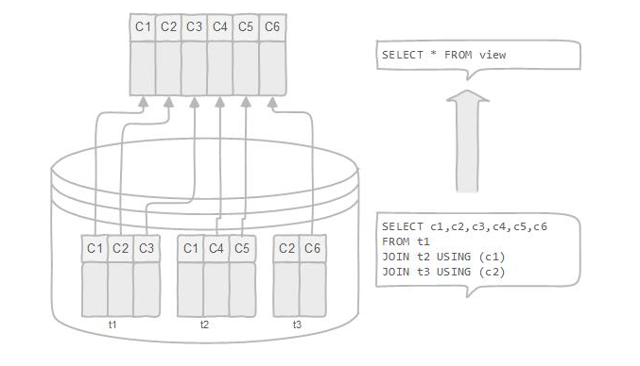
View
Logical or virtual way of storing data in database
Does not store data physically
Logical table based on a table or another view

Slide 3
Advantages and Disadvantages of view
Performance degradation
Update restrictions
Advantages
Disadvantages
To restrict data access
To make complex queries easy
To provide data independence
To present different views of the data

Slide 4
Types of view
Simple view
Complex view
Features | Simple View | Complex View
Number of tables | one | One or more
Functions | no | yes
Group of Data | no | yes
DML operations through a view | yes | Not always possible

Slide 5
Simple view
Data is derived from only one base table or is created from only one table
Contains no functions or group of data
DML operations can be performed through simple view

Slide 6
Complex view
Data is derived from one or more than one tables
Contains functions
Contains group of data
DML operations could not always be performed through a complex view

Slide 7

Creating a view
To create a view , we can use CREATE VIEW statement.
Syntax for creating a simple view:
In the above syntax OR REPLACE parameter and WHERE condition are optional

Slide 8

Retrieving data from a view
Syntax for retrieving data from a view:
We can also apply different conditions while extracting data from a view .

Slide 9

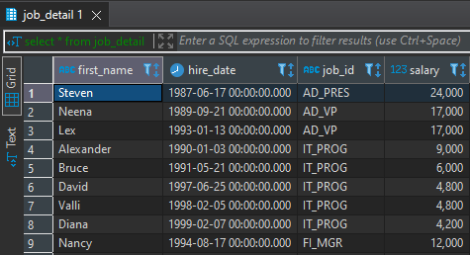
Creating a simple view
View name
Specific columns
Base table

Slide 10
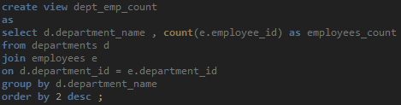
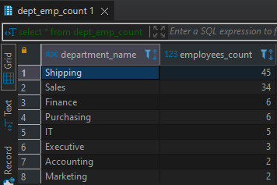
Creating a complex view
Group function
Multiple tables
Data grouping

Slide 11
Rules for performing DML operations through a view
We cannot always perform DML operations through views
Group functions
GROUP BY clause
The DISTINCT keyword
The pseudocolumn ROWNUM keyword

Slide 12
Removing a view
We can simply remove a view with the help of the syntax below:
Removing a view does not affect the underlying tables

Slide 13
Materialized view
Special type of view which stores data physically
Unlike view , materialized view stores results of a query physically and takes up space
Data need to be refreshed periodically either manually or by using trigger
Data are stored physically so faster in comparison to view

Slide 14
Advantages and Disadvantages of materialized view
Data are stored physically therefore consumes storage
Need to be refreshed periodically or by using trigger to update to the latest data
Advantages
Disadvantages
Faster in comparison to view
can be indexed and partitioned
Useful for remote applications and performance tuning

Slide 15

Creating a materialized view
We can create a simple materialized view from the syntax below:

Slide 16
Refreshing a materialized view
Has to be refreshed manually
We can refresh materialized view with the help of refresh statement
Can also be used automatically with function and trigger

Slide 17
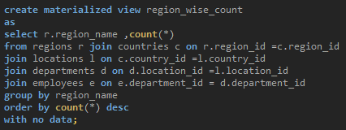

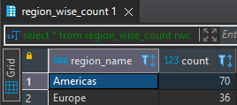

Slide 18
Dropping materialized view
The following statement is used to drop the materialized view from the database

Slide 19
View vs Materialized view
Features | View | Materialized view
Representation | Logical representation of base tables | Physical representation
Storage | Does not takes disk storage | Stored on a disk
Refresh view | Always updated to the latest data | Has to be updated manually or with the help of triggers
Speed | Overall performance of view is slower than that of materialized view | Stored physically making it easier for users to access data faster
Use | Usually used when data is rarely used and table data is frequently updated | Used when data needs to be accessed frequently and the data in the table is not updated frequently
Syntax | CREATE VIEW view_name AS query | CREATE MATERIALIZED VIEW view_name AS query

Slide 20
Index
Object by which we can retrieve rows or data faster
Can be created by using one or multiple columns
Common way of enhancing database performance
Logically and physically independent of the indexed table

Slide 21


Creating/Removing an index
Automatically created when we define PRIMARY KEY or UNIQUE constraint in a table
Can also be created manually by using the following syntax:
Can be removed by using following syntax:

Slide 22
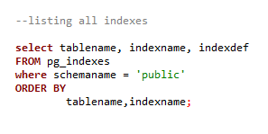
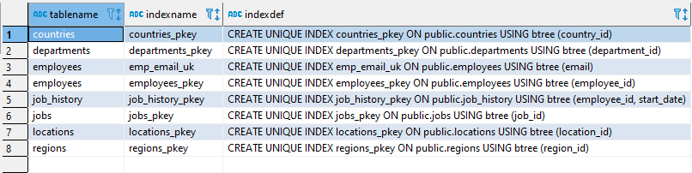
Listing indexes
Pg_indexes view allows us to access information on each index

Slide 23
Types of index
B-Tree
Bitmap
HASH
GIST (generalized Inverted Search Tree)
SP-GIST( space partitioned generalized Inverted Search Tree)
GIN (Generalized Inverted Index)
BRIN (Block Range Index)

Slide 24
B-Tree index
Default and most commonly used index
Most useful when there are many unique rows
Self balancing tree that maintains sorted data and allows search, insertions etc. in logarithmic time

Slide 25
Bitmap index
Special kind of database index that uses bitmaps
Most useful for columns with low-cardinality having a modest number of distinct values
Each rowed is assigned a unique bitmap

Slide 26
HASH index
Can only handle simple equality comparison (=)
To create hash index, we can use CREATE INDEX statement with HASH index type in the USING statement
Can provide faster data lookups than other indexes in some cases

Slide 27
GIST index
Referred as Generalized inverted search tree
To create GIST index, we can use CREATE INDEX statement with GIST index type in the USING statement
Useful in indexing geometric data types and full-text search

Slide 28
SP-GIST index
Referred as Space-Partitioned Generalized Inverted Search Tree(GiST)
Useful for data having natural clustering element
For example GIS, multimedia, phone numbers , ip routing

Slide 29
GIN index
Referred as Generalized Inverted Index
Most useful when multiple values are stored in single column
Hstore, Arrays , json etc..

Slide 30
BRIN index
Stands for Block Range Index
Much smaller and less costly to maintain
Can be used on a table with large amount of data
Often used on a column that has linear sort order

Slide 31
Avoiding index
Tables with small data
Tables having frequent, large batch of insert and update operations
Column with high null values
Creating multiple index on a single column

Slide 32
THANK YOU!!

